Slide 1
CS60055: Ubiquitous Computing
Location, Gesture and Activity Sensing
Part IV: Inferring Activities from IMU

Slide 2
What We Have Learnt So Far?
IMU sensors are noisy
  Accelerometer measures true acceleration – needs to separate out the gravity component; however, gravity value gets polluted when the object is in motion
  Integrations make the errors cumulative: Orientation and location estimations become noisy
  Magnetic north pole can be used as an anchor, but it is also not free from noise
Combine measurement logic with the application-enforced physics for gesture estimation
  Statistical estimators/filters can help
  Tradeoff between accuracy and real-time performance

Slide 3
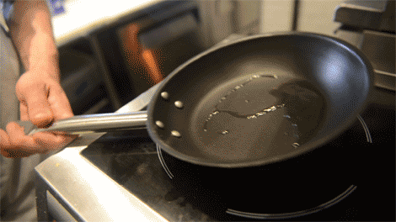
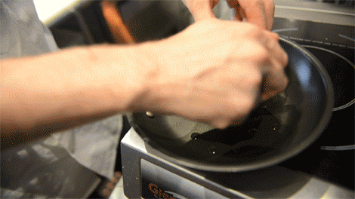
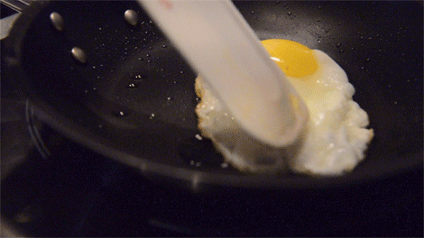
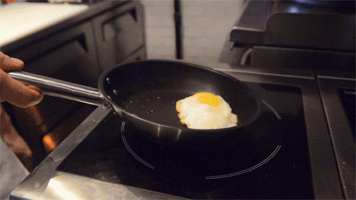
The Next Steps – Gesture to Activities
Combine the gestures to infer the activities
Cooking

Slide 4
The Next Steps – Gesture to Activities
Combine the gestures to infer the activities
Preparing poached egg
However, the activity label can be more precise depending on the downstream application

Slide 5
Human Activity Recognition (HAR)
Can use handcrafted statistical features from the gesture signatures
  Mean, mode, median, kurtosis, etc.
However, these features need to be extracted and engineered properly
  Note that there is a fundamental difference between image/video processing and physical sensor data processing
  IMU data is not visually recognizable like image or video data – so data annotation and model development is tricky
  How do you understand which statistical features are more prominent for a specific type of activity patterns?
  Also, activity signatures vary a lot across demography, age, gender, etc.

Slide 6
Human Activity Recognition (HAR)
Can we use vision models for HAR?
  The image representation of the accelerometer data and pass it to the vision-based model for activity classification?

Slide 7
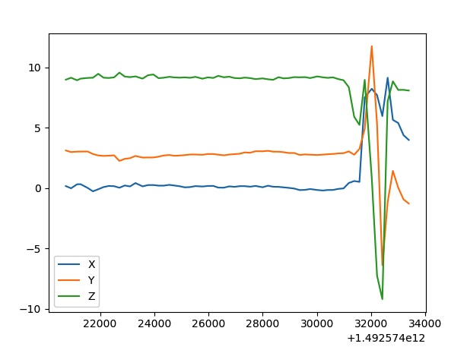
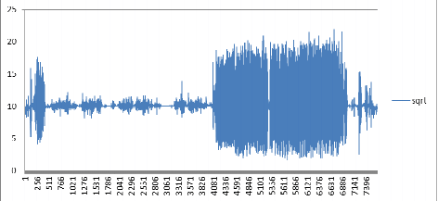
Human Activity Recognition (HAR)
Can we use vision models for HAR?
  Take a matrix representation of the input: The image representation of the accelerometer data and pass it to the vision-based model for activity classification?
  May lose a lot of contextual information depending on the resolution and granularity of the data – what would be the optimal resolution for the input?
  Also, data from multiple modalities (accelerometer, gyroscope, compass) need to be combined to define the motion model properly

Slide 8
Human Activity Recognition (HAR)
Can we use vision models for HAR?
  Take a matrix representation of the input: The image representation of the accelerometer data and pass it to the vision-based model for activity classification?
  May lose a lot of contextual information depending on the resolution and granularity of the data – what would be the optimal resolution for the input?
  Also, data from multiple modalities (accelerometer, gyroscope, compass) need to be combined to define the motion model properly
A Possible Solution: Use supervised models on the preprocessed IMU data for HAR classification

Slide 9
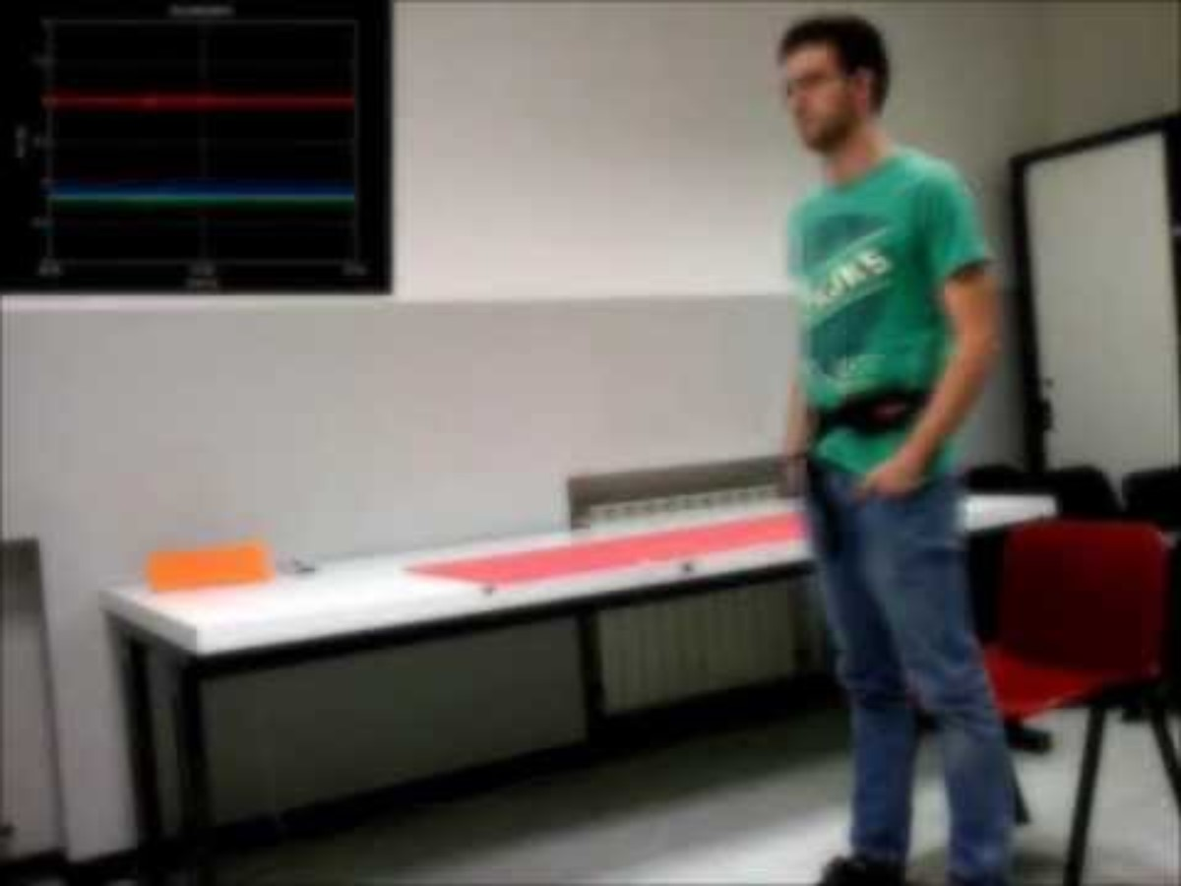
Deep Learning for HAR
Represent the raw time-series data (after the necessary preprocessing and filtering) from the IMU as your input
  No hand-crafted feature engineering is necessary
UCI-HAR dataset, several activity classes:
Walking
Walking upstairs
Walking downstairs
Sitting
Standing
Laying
https://archive.ics.uci.edu/dataset/240/human+activity+recognition+using+smartphones

Slide 10
Deep Learning for HAR
1D-CNN to predict the feature classes
  Can learn from the raw time series data directly (accelerometer and gyroscope)
  Do not require domain expertise for manual feature engineering
Input: three time-series signals (3-DoF representation)
  Total acceleration (gravitational acceleration + body acceleration)
  Body acceleration
  Body gyroscope
Window the input data – one sample is one window
  128 time-steps
Multi-class classification
  Adam optimizer, categorical cross entropy loss
  Tune hyperparameters (kernel size, number of filters) to best fit the model

Slide 11
Deep Learning for HAR
1D-CNN to predict the feature classes
  Can learn from the raw time series data directly (accelerometer and gyroscope)
  Do not require domain expertise for manual feature engineering
Input: three time-series signals (3-DoF representation)
  Total acceleration (gravitational acceleration + body acceleration)
  Body acceleration
  Body gyroscope
Window the input data – one sample is one window
  128 time-steps
Multi-class classification
  Adam optimizer, categorical cross entropy loss
  Tune hyperparameters (kernel size, number of filters) to best fit the model
Cons: You still need a significant amount of labelled data to train your model

Slide 12
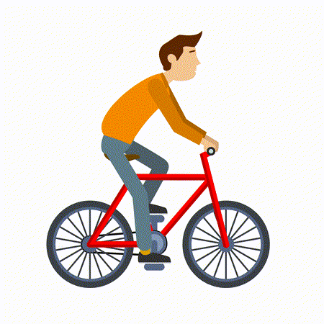
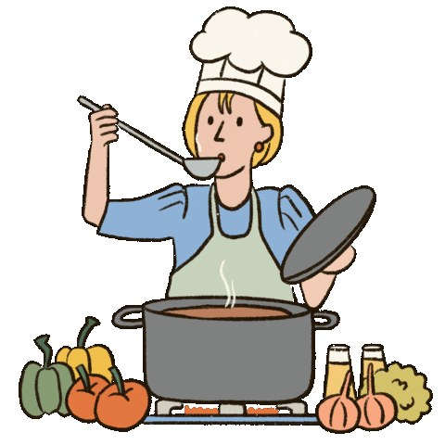
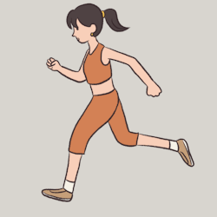
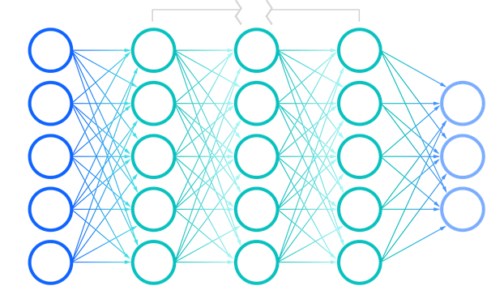
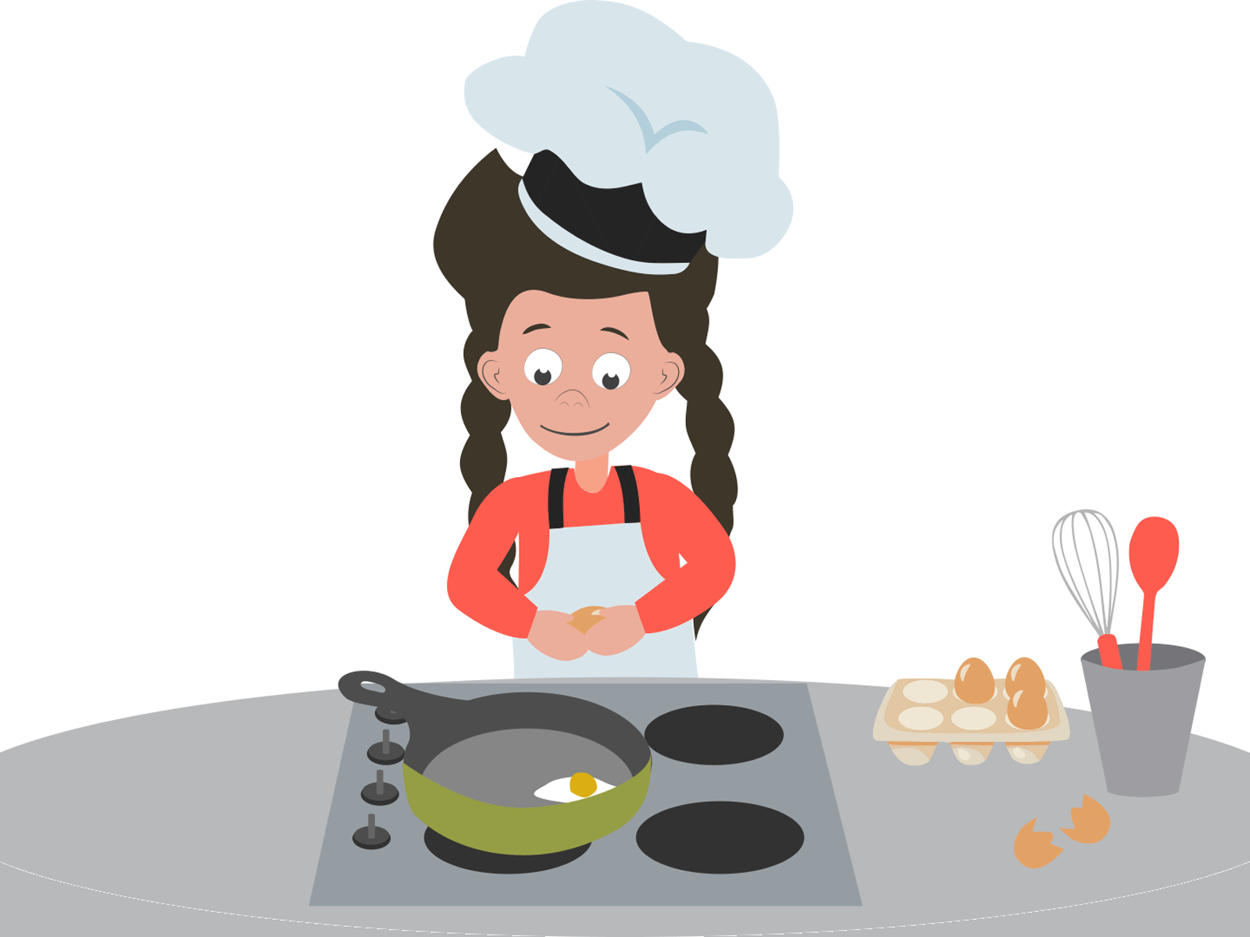
Self-Supervised Learning (SSL) for HAR
Self-supervised Learning (SSL)
  Does not rely on the labelled dataset for supervisory signals
  Generate implicit labels from the unstructured data
Pretext task
Representation
Cooking
Classifier
Representation

Slide 13
Contrastive Learning
Pick up an anchor – the target that you want to learn
  Positive (X+): Samples that are similar to the anchor (similar semantic meaning)
  Negative (X-): Samples that are different from the anchor
Pull Anchor and Positive embeddings closer and push the Anchor and Negative embeddings further

Slide 14
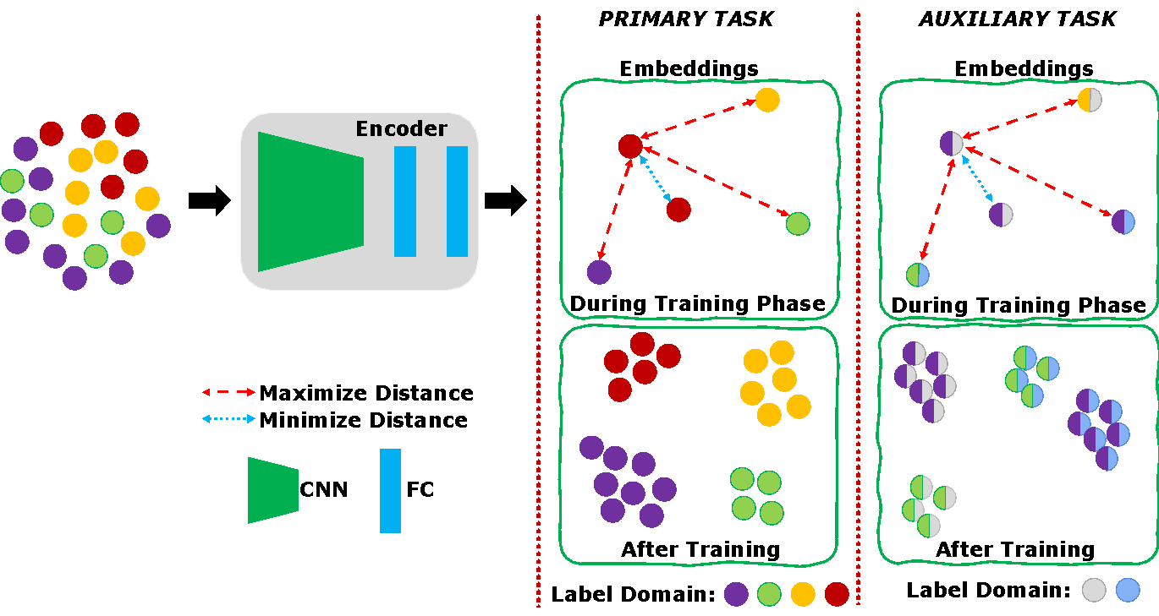
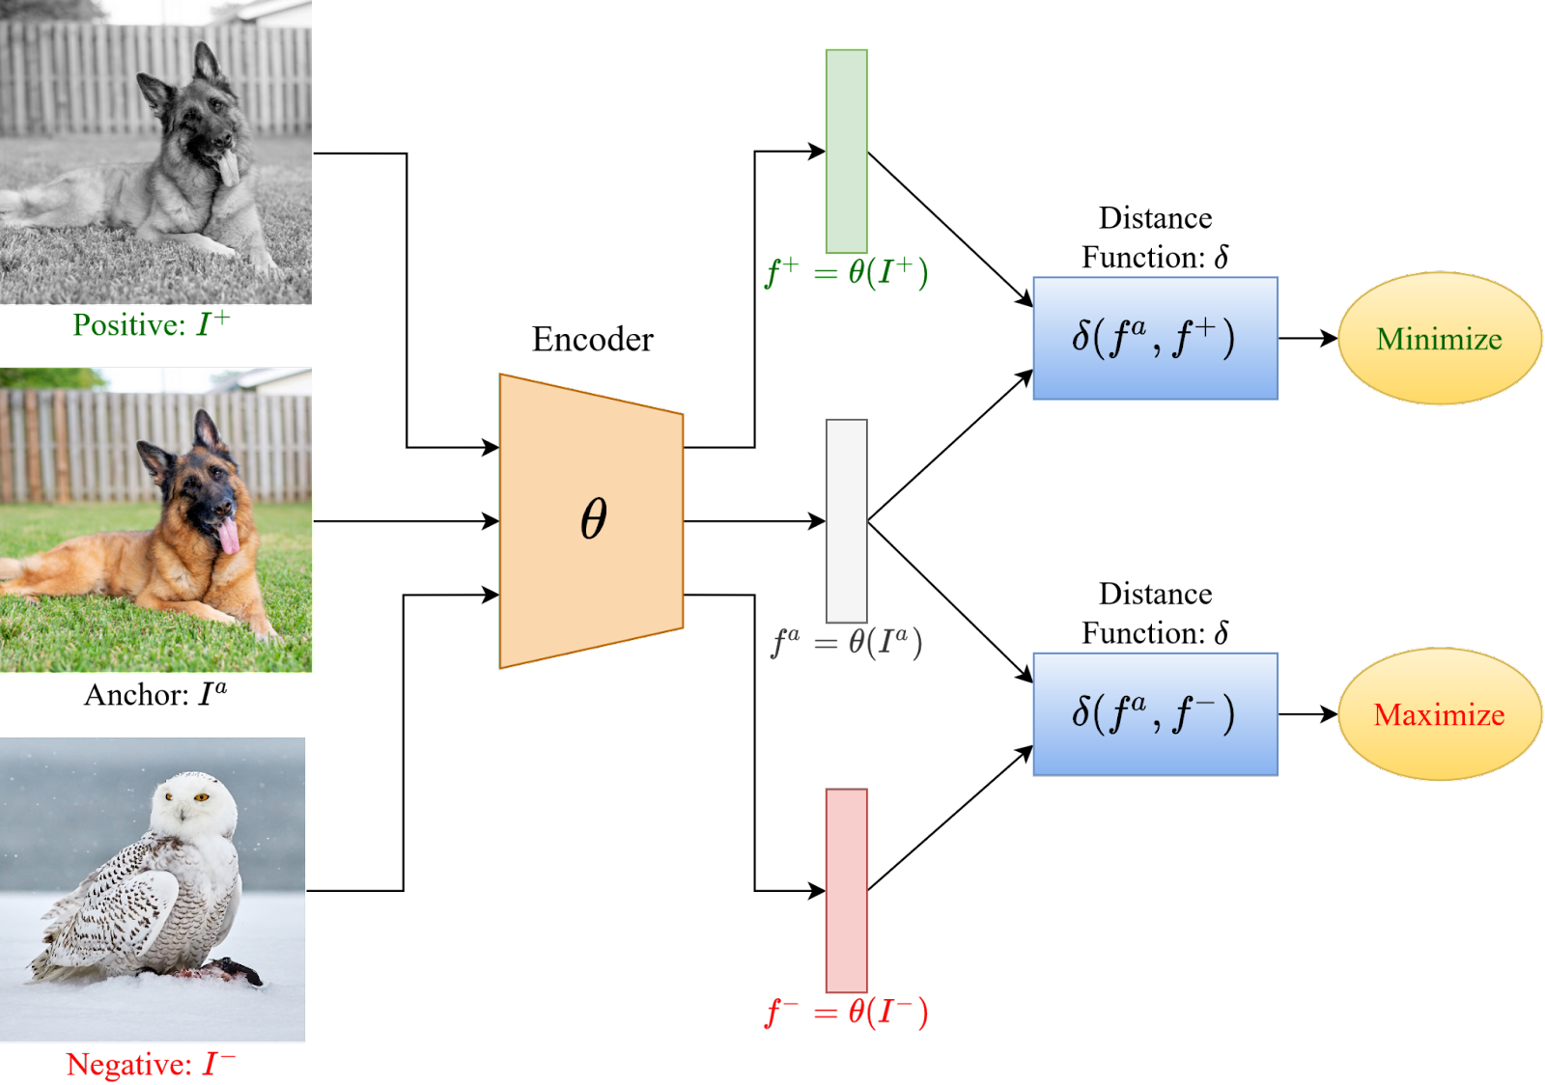
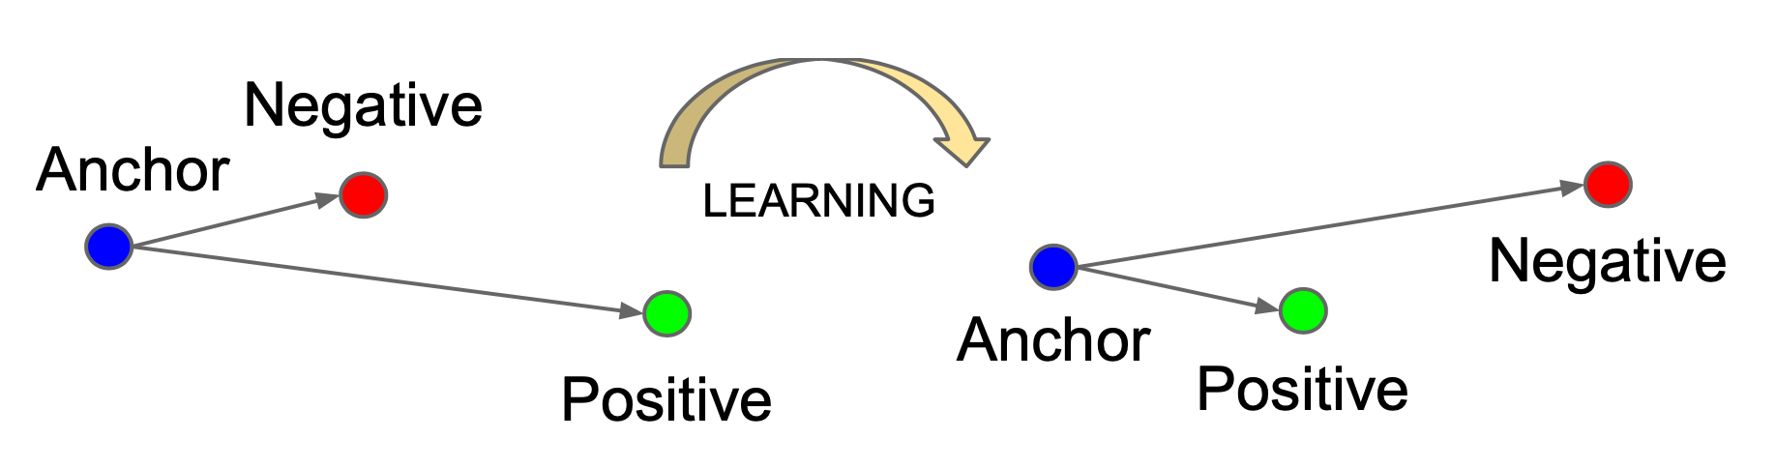
Contrastive Learning

Slide 15
Contrastive Learning
Loss Function:
Triplet loss:
Other loss functions are also available
Lifted Structured Loss (all pair)
  N-pair Loss (Multiple Negatives)
  NCE (Noise contrastive estimation)
  And so on ….

Slide 16
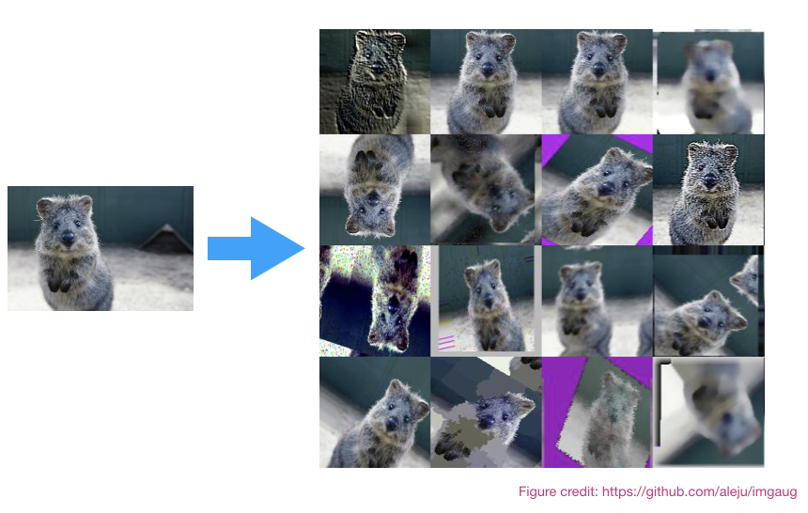
Contrastive Learning
How do you get the positive samples without labeling?
  Positive: Pick up a few anchors and apply augmentations
  Negative: Everything else
Contrastive learning is popular in the image domain
  Augmentation is easy
  Well defined semantic augmentations that do not
  change the meaning of the subjects
    Flip
    Rotate
    Color distortion
    Random crop
    Zooming
    Blur, and so on …
Slide credit: Prasenjit Karmakar

Slide 17
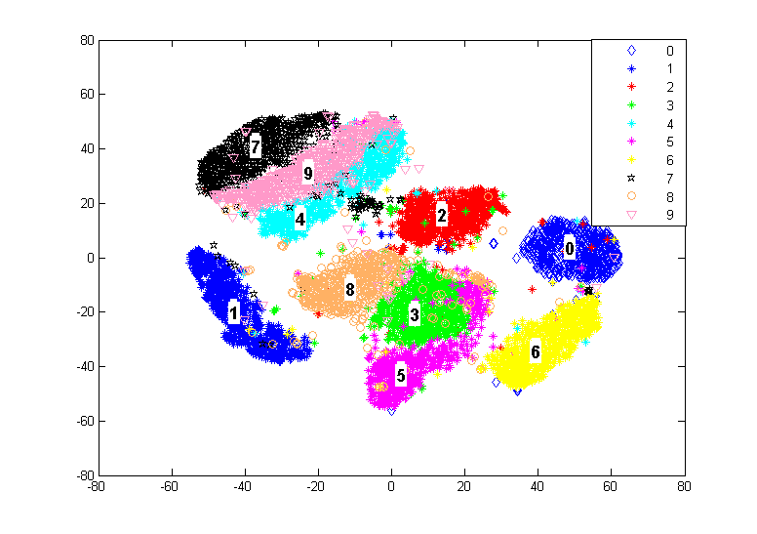
MNIST Representations
Learned M dimensional Embedding Vector for which below properties holds
  Two similar images are embedded closely in the M dimensional space as compared to two dissimilar images, forming clusters.
  Two such cluster should have minimal to no overlap (GOOD for downstream classification)
Two dimensional MNIST representations
Slide credit: Prasenjit Karmakar

Slide 18
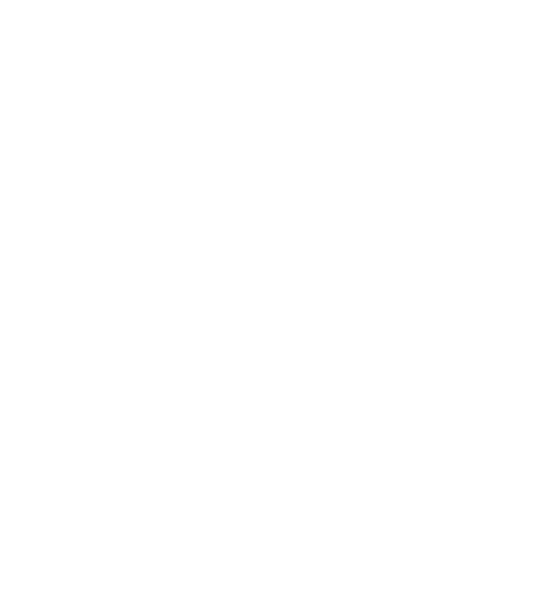
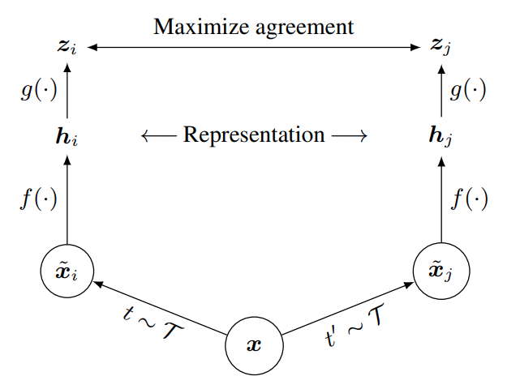
SimCLR
One of the simplest but effective contrast learning framework for vision-based classification
Gif source: https://medium.com/analytics-vidhya/eli5-a-simple-framework-for-contrastive-learning-of-visual-representations-20d9509d0a12

Slide 19
SimCLR
One of the simplest but effective contrast learning framework for vision-based classification
How do we apply data augmentation for physical sensing data?
Gif source: https://medium.com/analytics-vidhya/eli5-a-simple-framework-for-contrastive-learning-of-visual-representations-20d9509d0a12

Slide 20
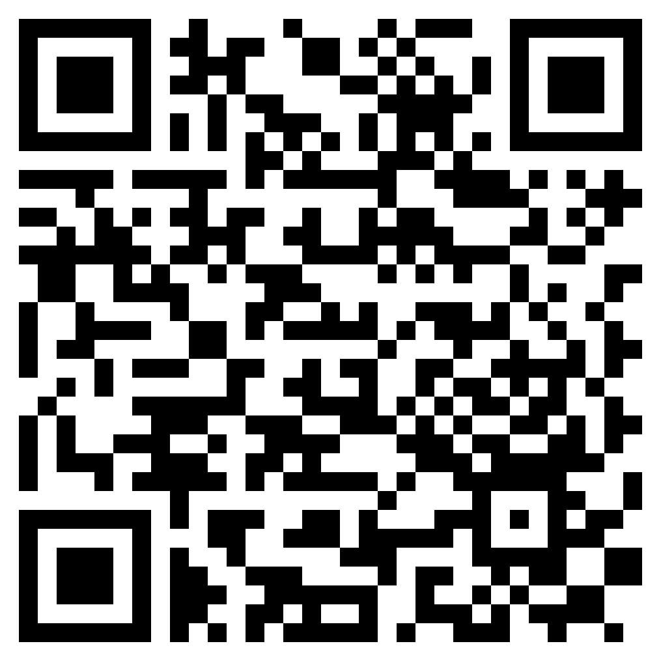
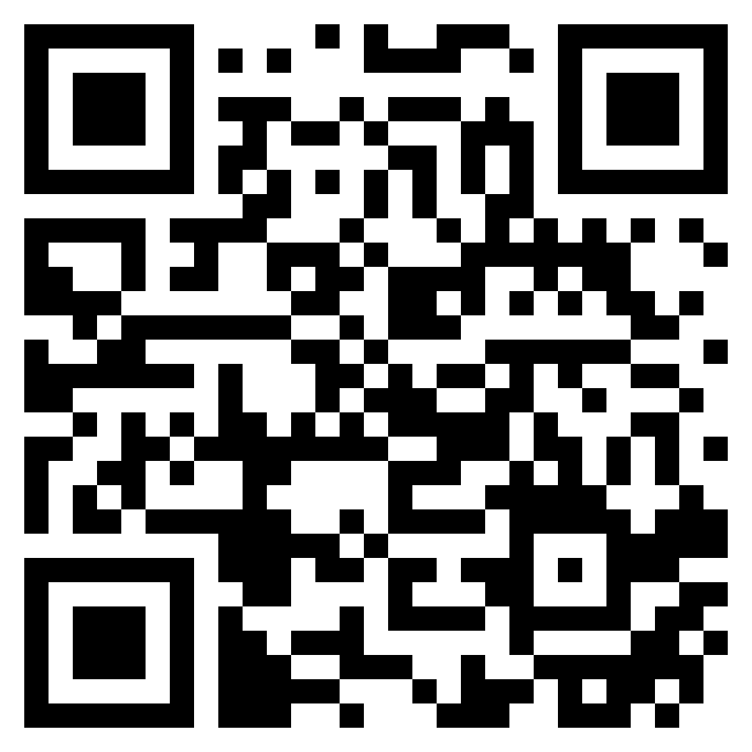
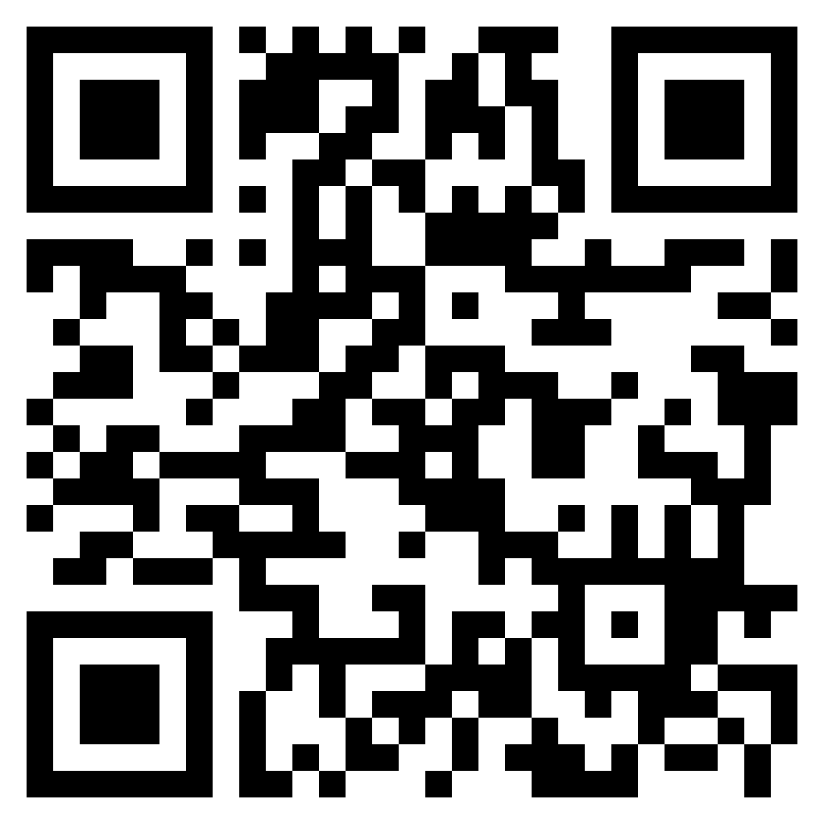
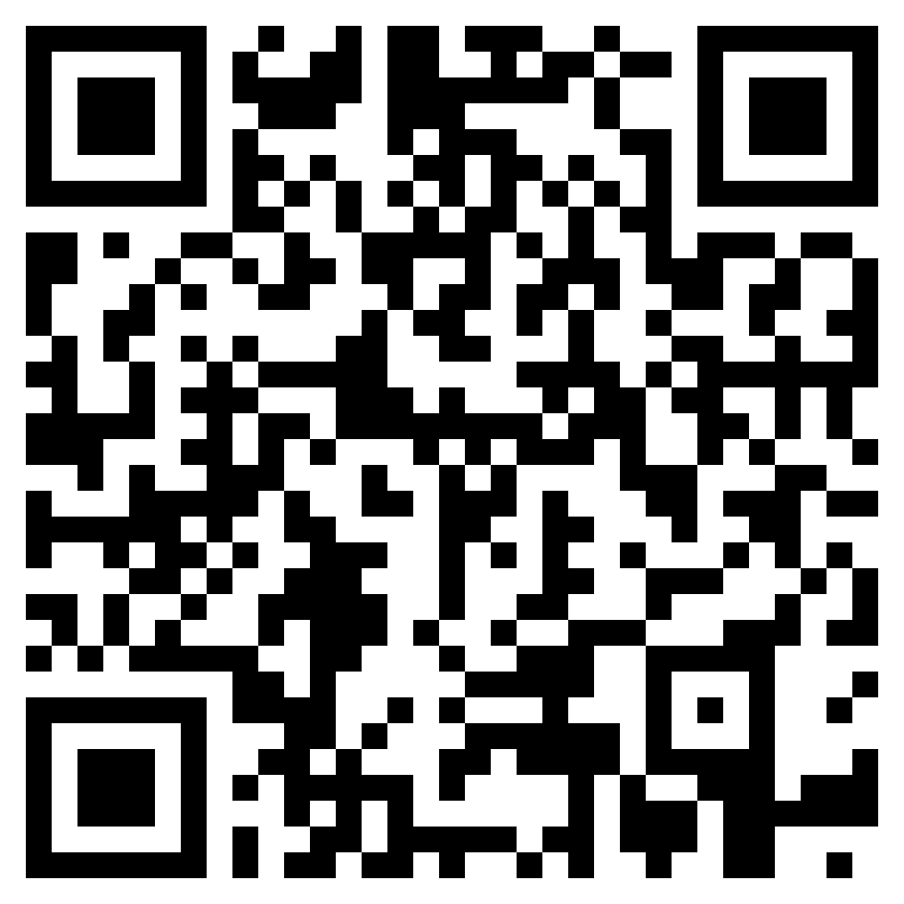
SimCLR
One of the simplest but effective contrast learning framework for vision-based classification
How do we apply data augmentation for physical sensing data?
Apply the laws of physics
Gif source: https://medium.com/analytics-vidhya/eli5-a-simple-framework-for-contrastive-learning-of-visual-representations-20d9509d0a12

Slide 21
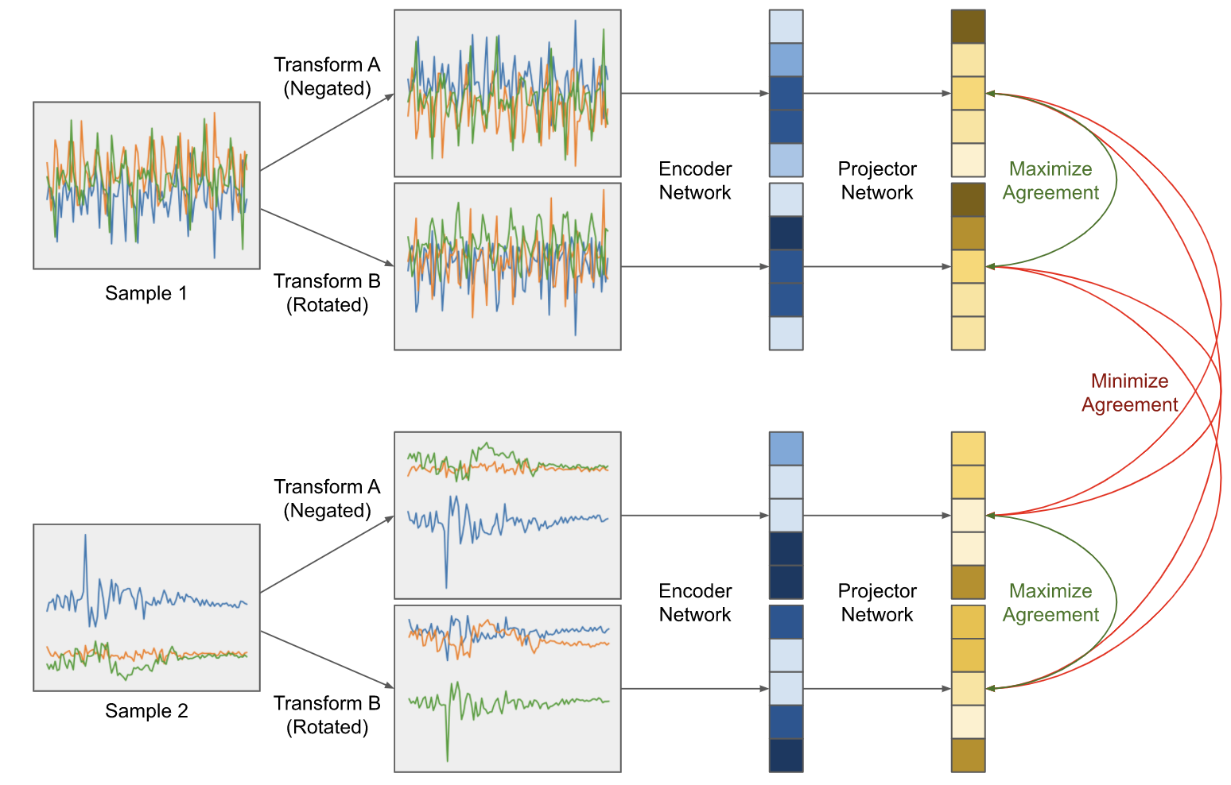
Contrastive Learning for HAR
Adoption of SimCLR framework for HAR

Slide 22
Contrastive Learning for HAR
What transformations can we apply for the HAR data?
Adoption of SimCLR framework for HAR

Slide 23
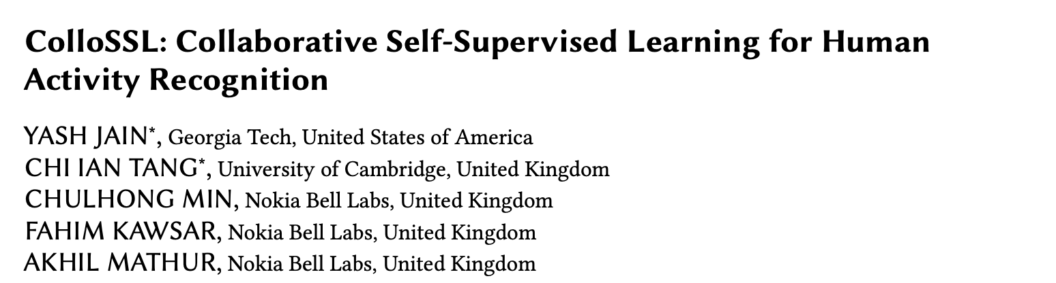
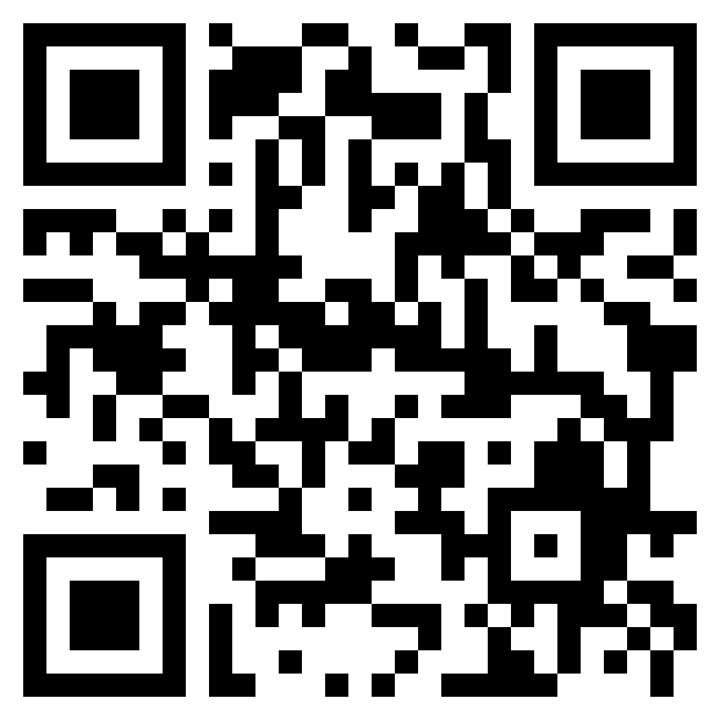
Contrastive Learning for HAR
IMWUT 2022
https://github.com/iantangc/ContrastiveLearningHAR

Slide 24
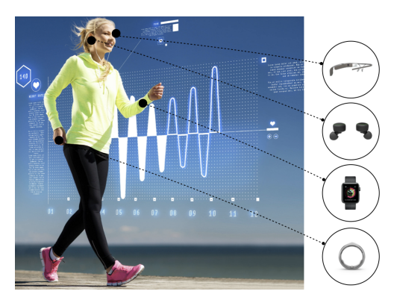
Time Synchronous Multi Device Systems (TSMDS)
Multiple computing/sensor devices are worn on, affixed to or implanted in a person’s body
  All devices observe a physical phenomenon (e.g., a user’s locomotion activity) simultaneously and record sensor data in a time-aligned manner
Assumptions
  All sensor devices in the multi-device system
  share the same sensor sampling rate (or that
  their data can be re-sampled to the same rate)
  Multiple devices in collect sensor data in a
  time-aligned manner (minor variations do not
  impact the performance significantly)

Slide 25
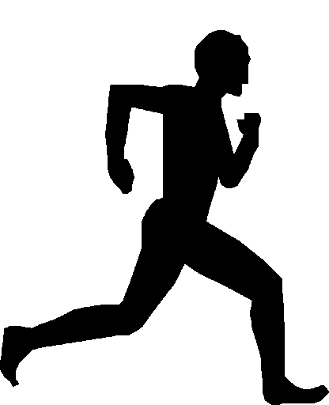
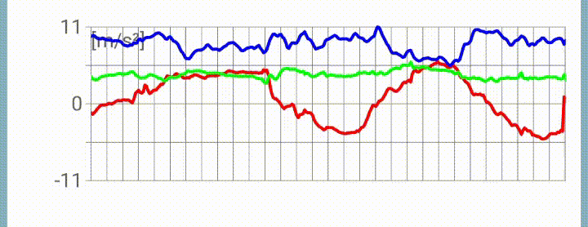
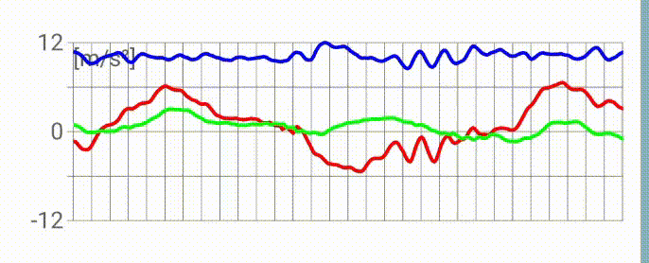
Transformations for Data Augmentation
Rather than applying manual transformations (like rotation), can we utilize natural transformations that are already available in the sensor datasets
  Multiple sensors in a TSMDS system captures the same activity under different view
Both indicate the same activity "Running"

Slide 26
Transformations for Data Augmentation
Rather than applying manual transformations (like rotation), can we utilize natural transformations that are already available in the sensor datasets
  Multiple sensors in a TSMDS system captures the same activity under different view
These are natural transformations of each other!

Slide 27
Transformations for Data Augmentation
Rather than applying manual transformations (like rotation), can we utilize natural transformations that are already available in the sensor datasets
  Multiple sensors in a TSMDS system captures the same activity under different view
Accelerometer and Gyro at different body parts capture the translational and the rotational motions of those body parts
  For an activity, the motions at different body parts are interlinked
  Think about the motion patterns of hands and legs when
  you are running!

Slide 28
Transformations for Data Augmentation
Rather than applying manual transformations (like rotation), can we utilize natural transformations that are already available in the sensor datasets
  Multiple sensors in a TSMDS system captures the same activity under different view
Accelerometer and Gyro at different body parts capture the translational and the rotational motions of those body parts
  For an activity, the motions at different body parts are interlinked
  Think about the motion patterns of hands and legs when
  you are running!
Use such natural transformations to define a pretext task and perform contrastive learning

Slide 29
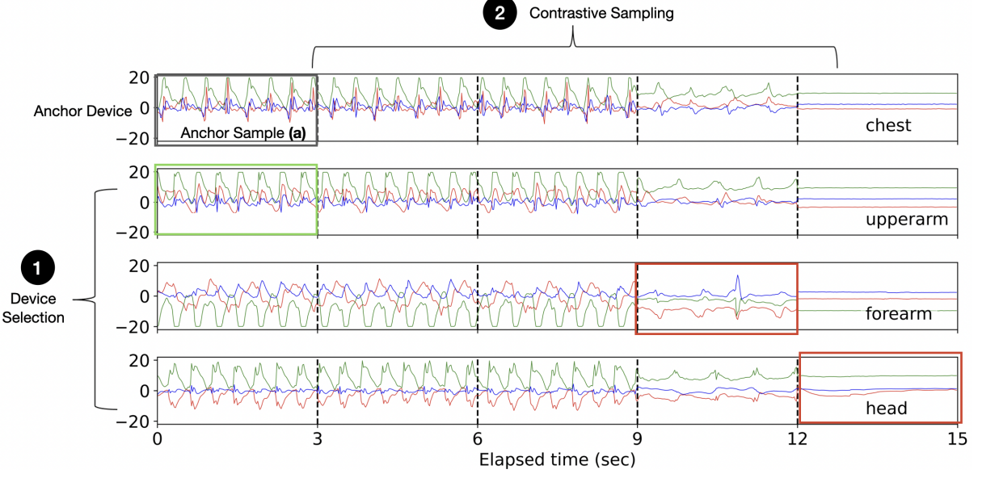
Challenge 1: Selecting Positive and Negative Samples

Slide 30
Challenge 1: Selecting Positive and Negative Samples
Data distributions for some devices will be very different from the data distribution of Chest – can be the "negative" samples!
How do we know which are of different distributions?

Slide 31
Challenge 1: Selecting Positive and Negative Samples
Positive
Negative

Slide 32
Challenge 2: Which Samples Can be Used in CL?

Slide 33
Challenge 2: Which Samples Can be Used in CL?
Pattern gets very different

Slide 34
Collaborative Self-supervised Learning
We have D devices with time-aligned but unlabeled sensor datasets {X_{i}}^{D}_{i=1}
The dataset is pre-segmented in T number of windows
  Each dataset X_{i} contains T windows {x¹_{i} , x²_{i} , …, x^{T}_{i}}
  Each sensor sample x^{j}_{i} is the 6-DoF IMU data
Let D* ∈ D be an anchor device for which we want to train HAR prediction
Let L* = {(x*¹, y*¹), …, (x*^{m}, y*^{m})} be a small pre-segmented labeled dataset from the anchor device with m windows (m << T)
  X* are the sensor samples, y* are the labels
Objectives:
  Use the unlabeled dataset {X_{i}}^{D}_{i=1} to train a feature extractor f(.)
  Use the pretrained f(.) to obtain the feature embeddings for the labeled anchor samples and subsequently train an HAR classifier g(.) that maps feature embeddings to the labels

Slide 35

Solution Steps
Initialize the feature extractor f(.) with random weights
Sample a batch 𝐵 of time-aligned unlabeled data from all the D devices
Device Selection: Decide which of the remaining devices will provide positive samples and negative samples for CL
Contrastive Sampling: For each anchor sample, which samples from the batches of positive and negative devices should be used for CL

Slide 36
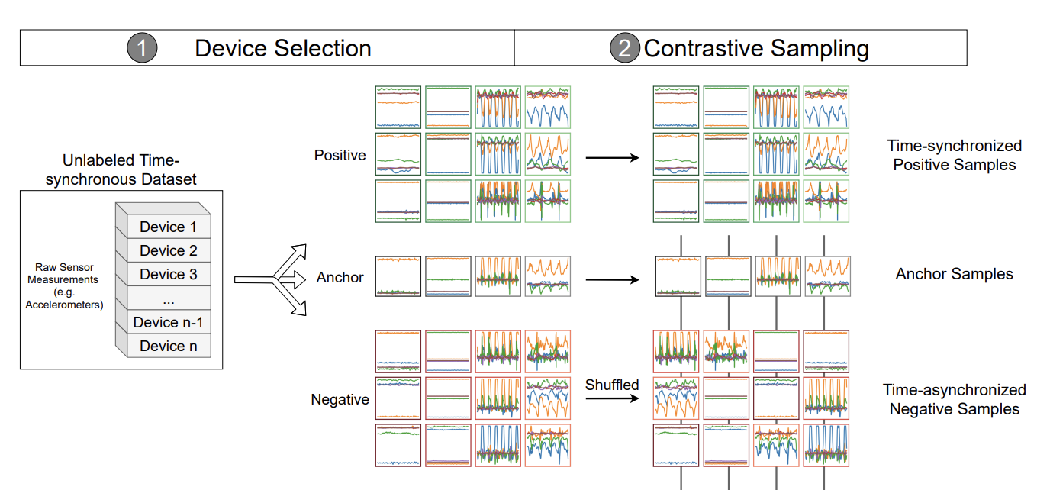
Solution Steps

Slide 37
Solution Steps
Multi-view Contrastive Learning: The anchor, positive and negative sample(s) are fed to the feature extractor f(.) to generate feature embeddings
  Use 1D-CNN as the feature extractor
  Compute Multi-view Contrastive Loss to push the positive samples towards the anchor and the negative embeddings far from the anchor
Repeat the above steps until the contrastive loss converges (and we compute all the anchor samples for the batch)
Supervised Fine Tuning: Train a HAR classifier using f(.) and the labeled dataset from the anchor device

Slide 38
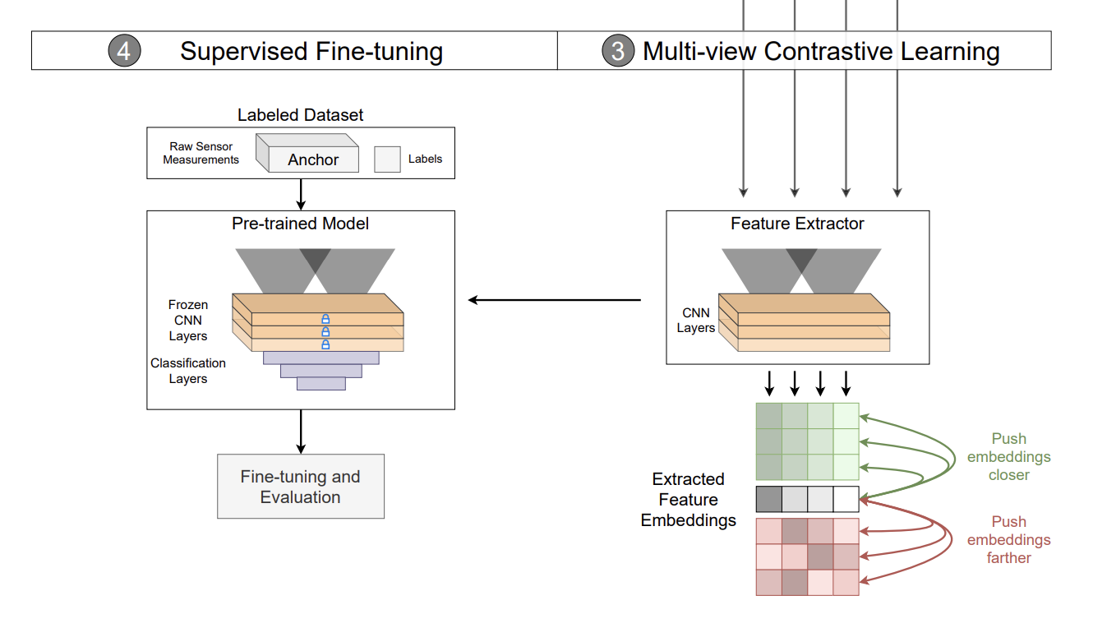
Solution Steps

Slide 39
Device Selection
'Good' positive samples (𝑥⁺):
  𝑥⁺ should belong to the same label/class as the anchor sample 𝑥
  𝑥⁺ should come from a device whose data distribution has a small divergence from that of the anchor device.

Slide 40
Device Selection
'Good' positive samples (𝑥⁺):
  𝑥⁺ should belong to the same label/class as the anchor sample 𝑥
  𝑥⁺ should come from a device whose data distribution has a small divergence from that of the anchor device.
We do not have ground truth data, so how do we ensure this condition?

Slide 41
Device Selection
'Good' positive samples (𝑥⁺):
  𝑥⁺ should belong to the same label/class as the anchor sample 𝑥
  𝑥⁺ should come from a device whose data distribution has a small divergence from that of the anchor device.
The Catch: Devices are time-aligned in TSMDS. So, all the devices observe the same class label at every time window

Slide 42
Device Selection
'Good' positive samples (𝑥⁺):
  𝑥⁺ should belong to the same label/class as the anchor sample 𝑥
  𝑥⁺ should come from a device whose data distribution has a small divergence from that of the anchor device.
'Good' negative samples (𝑥⁻)
  𝑥⁻ should be a true negative (belongs to a different class)
  The most informative negative samples are those whose embeddings are initially near to the anchor embeddings, and 𝑓 needs to push them far apart.
    𝑓 gets a strong supervisory signal from the data and more useful gradients during training if the embeddings are initially near to the anchor
    Otherwise (if the embeddings are already far apart), 𝑓 will receive a weaker supervisor signal: May affect its convergence

Slide 43
Device Selection
'Good' positive samples (𝑥⁺):
  𝑥⁺ should belong to the same label/class as the anchor sample 𝑥
  𝑥⁺ should come from a device whose data distribution has a small divergence from that of the anchor device.
'Good' negative samples (𝑥⁻)
  𝑥⁻ should be a true negative (belongs to a different class)
  The most informative negative samples are those whose embeddings are initially near to the anchor embeddings, and 𝑓 needs to push them far apart.
    𝑓 gets a strong supervisory signal from the data and more useful gradients during training if the embeddings are initially near to the anchor
    Otherwise (if the embeddings are already far apart), 𝑓 will receive a weaker supervisor signal: May affect its convergence
Strictly enforcing this may not be possible

Slide 44
Device Selection
Increase the likelihood of selecting 'good' positive and negative samples
  Compute pairwise Maximum Mean Discrepancy (MMD) between the data samples from the anchor and other devices
  MMD: Distance between the feature means -> Higher MMD implies a larger distance between the two distributions
Device Selection Policy:
  Closest Positive: Least MMD distance from the anchor is chosen as the positive (empirically observed that one positive device gives the best performance)
  Weighted Negatives: All from the candidate set, but the feature contributions are weighted by the inverse of the MMD from anchor (satisfies the second requirement – negatives closer to the anchor gets more weight, also ensures the first requirement by enabling other devices to superceed the training when one negative device belongs to the same class as of the anchor)

Slide 45
Contrastive Sampling
Decides which data samples should be picked from each device for contrastive training
Sampling polcy
  Synchronous positive samples
  Asynchronous negative samples
Synchronous positive samples: Time-aligned positive counterparts from the positive device, corresponding to the anchors
Asynchronous negative samples: We need the samples from a different class – samples which are not time-synchronized with the positive class are "more likely" to be the samples from a different class

Slide 46
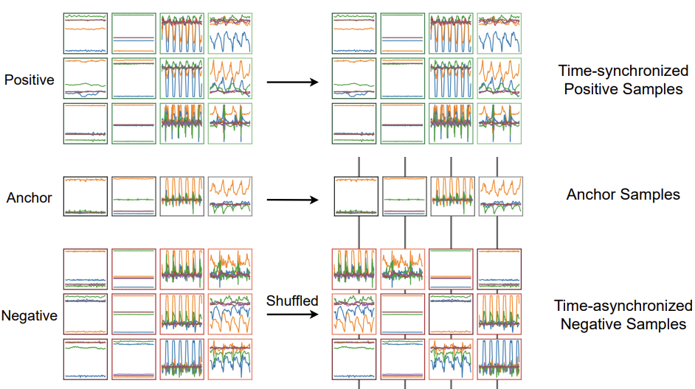
Contrastive Sampling

Slide 47
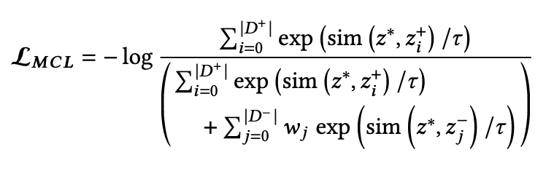
Multi-view Contrastive Loss
Extension of standard contrastive loss for multiple positive and negative samples:
  sim(.) indicates cosine similarity
The loss function is minimized for each batch of data using stochastic gradient descent
  Increases the cosine similarity between the anchor and positive samples (push them closer in the feature space)

Slide 48
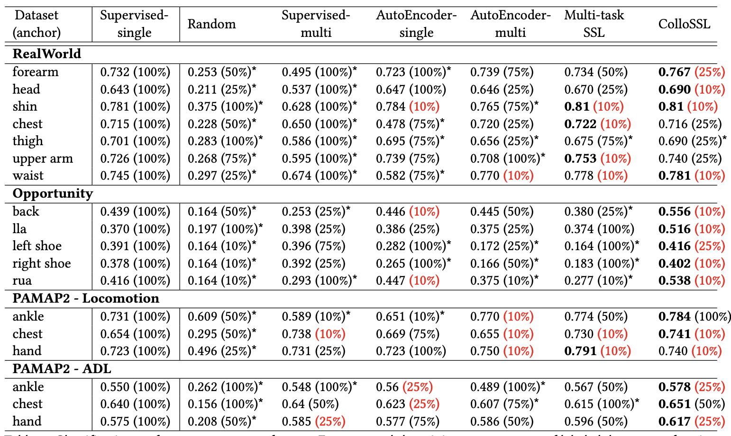
ColloSSL Performance (Macro F1 Score)
The number in the bracket indicates amount of data used

Slide 49
Take Aways
IMU can provide significant insights about human activities
  Motion models can well capture various gestures in different body parts
  One of the fundamental sensing modality used in almost every smart device
Statistical estimators/filters help denoising IMU data and predicting gestures
Obtained labeled data is costly for ubicomp applications
  Supervised methods are good if sufficient labels are available (but they are scarce)
  Unsupervised or semi-supervised/self-supervised methods may give reasonable performance with significantly less amount of data

Slide 50


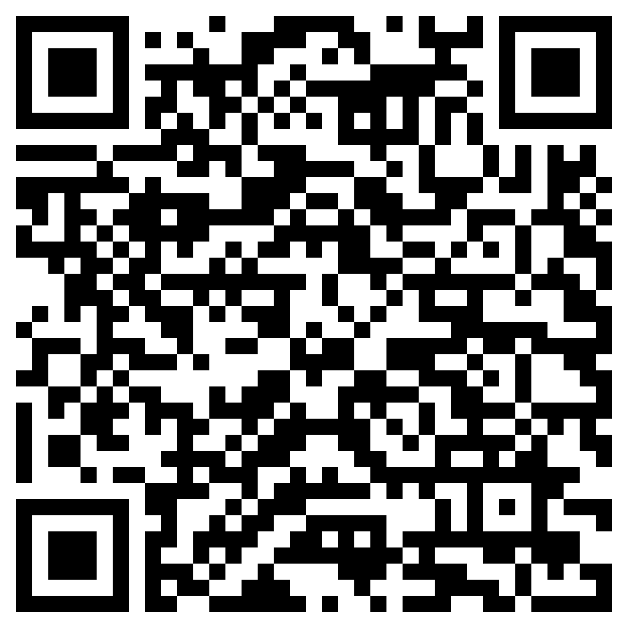
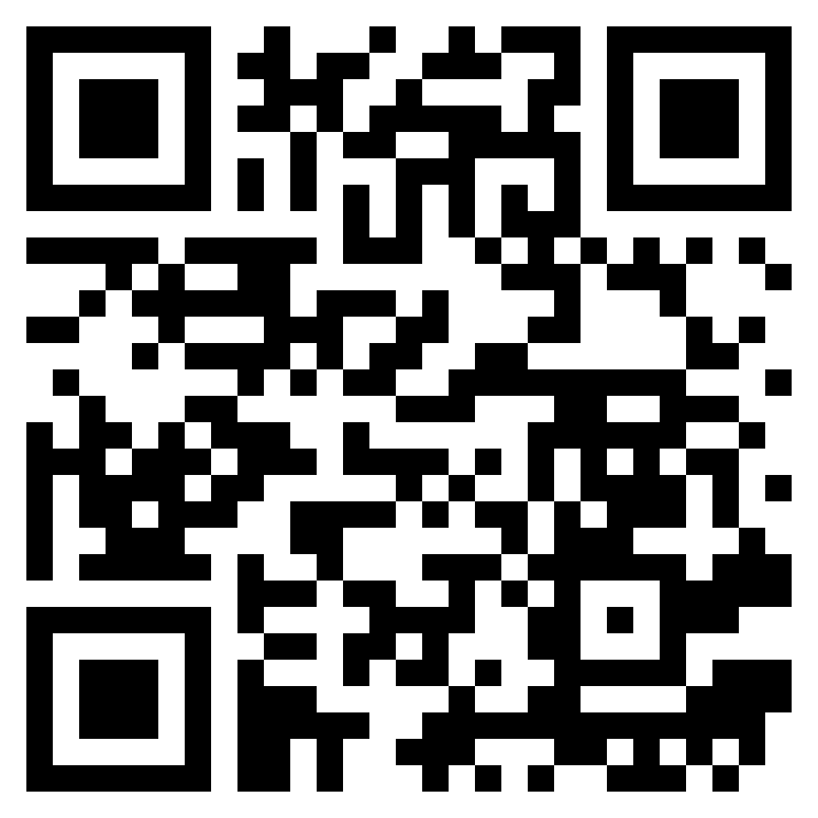
Happy Learning!
Some resources related to this topic

